Slide 1
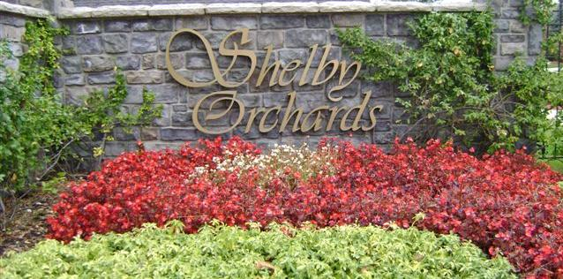
Annual Homeowners
Association Summary
November 2025

Slide 2
Agenda
Call to Order
Board Introductions
Treasurer’s Report
Old Business
New Business
2025/2026 Board Elections
Questions/Comments

Slide 3
Purpose of the Association
Enforce the covenants for compliance in order to maintain aesthetics, curb appeal, and property values.
Maintain, preserve, and administer the entrance wall, the sign and the landscaping in the landscape easement dedicated to the Homeowner Association
Collect and disburse the assessments and charges created in the Declaration of Covenants
Promote the recreation, health, safety and welfare of the residents in the Subdivision

Slide 4
2025 Board Members
President Lori Buscemi
Vice President Richard Moore
Treasurer Tom Swartz
Secretary Brandon Landino
Trustee Chris DiMarzo
Trustee Rich Tremblay

Slide 5
2025 Treasury Summary
Successfully collected all 2025 annual assessments
Increased savings through a balanced budget and maintained our goal of one year’s expenses in the bank.
Repaired sprinkler system in the front entrance.

Slide 6
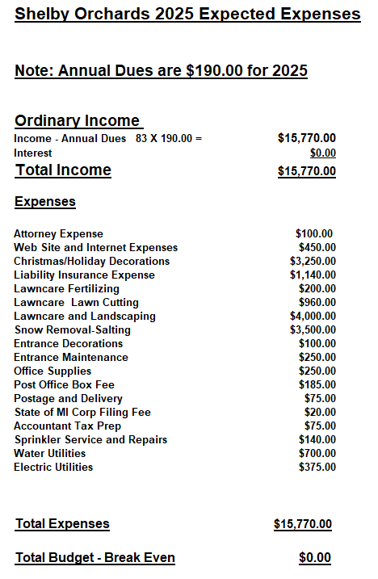

Slide 7
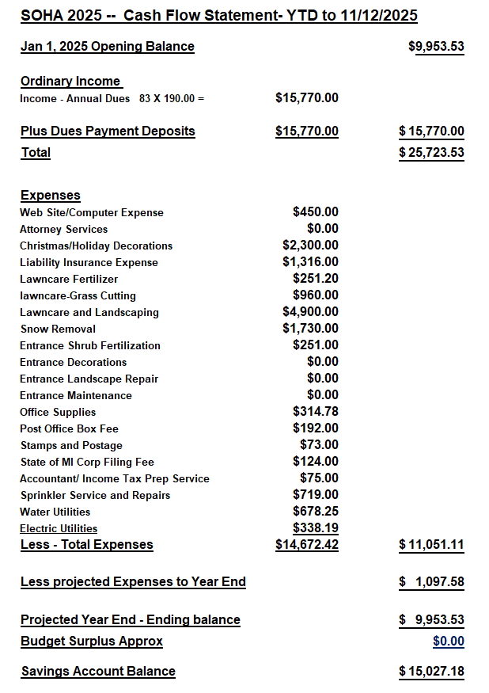

Slide 8
2026 Annual Dues and Budget
The 2026 dues will remain at $190 per household.
Expectation of 100% dues collection every year
2026 Budget is scheduled to break-even

Slide 9
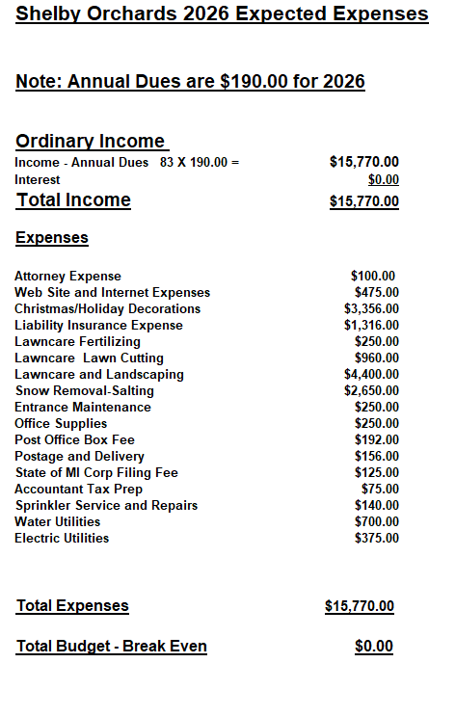

Slide 10
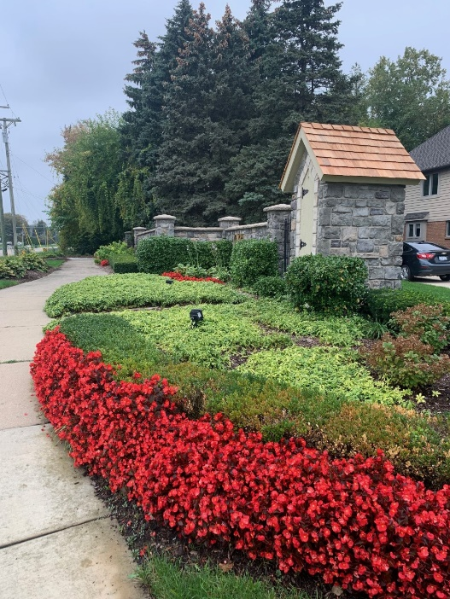
Old Business
2026 Contractors
  Front Entrance Maintenance – Same a prior year
  Snow Removal – Same as prior year
  Christmas Decorations – Same as prior year

Slide 11
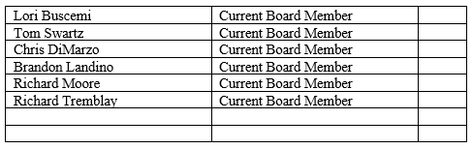
New Business
No new projects planned at this time
Board Elections – New Nominations?

Slide 12
