Slide 1
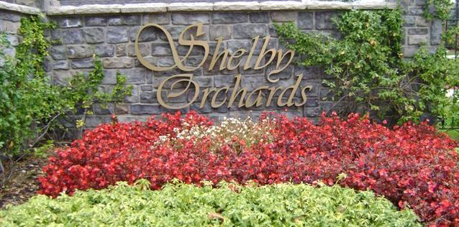
Annual Homeowners Association Meeting October 15, 2018

Slide 2
Agenda
Call to Order
Board Introductions
Treasurer’s Report
Old Business
New Business
2018/2019 Board Elections
Questions/Comments

Slide 3
Purpose of the Association
Enforce the covenants for compliance in order to maintain aesthetics, curb appeal, and property values.
Maintain, preserve, and administer the entrance wall, the sign and the landscaping in the landscape easement dedicated to the Homeowner Association
Collect and disburse the assessments and charges created in the Declaration of Covenants
Promote the recreation, health, safety and welfare of the residents in the Subdivision

Slide 4
2018 Board Members
President Lori Buscemi
Vice President Richard Moore
Treasurer Tom Swartz
Secretary Brandon Landino
Trustee Robert DiLabio
Trustee Chris DiMarzo
Trustee Rich Tremblay

Slide 5
2018 Treasury Summary
Successfully collecting 2018 annual assessments
Able to maintain a balanced budget by raising the annual dues for 2018.
Able to fund additional front entrance maintenance within the planned expenses

Slide 6
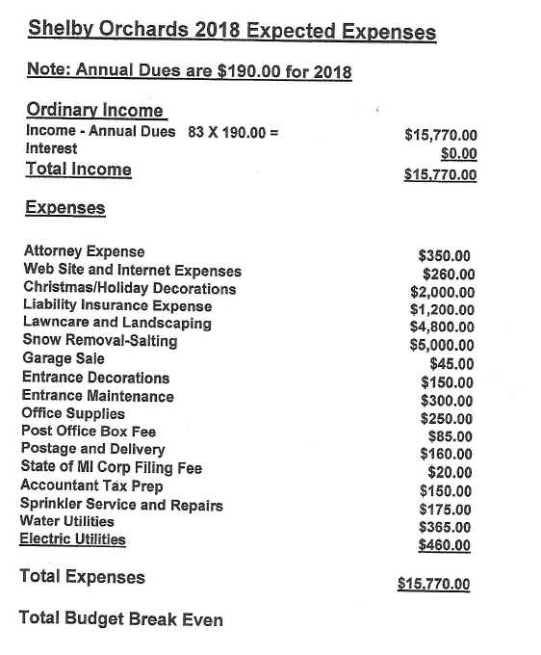

Slide 7
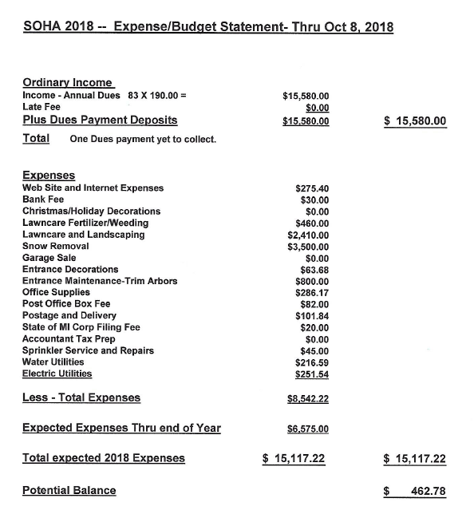

Slide 8
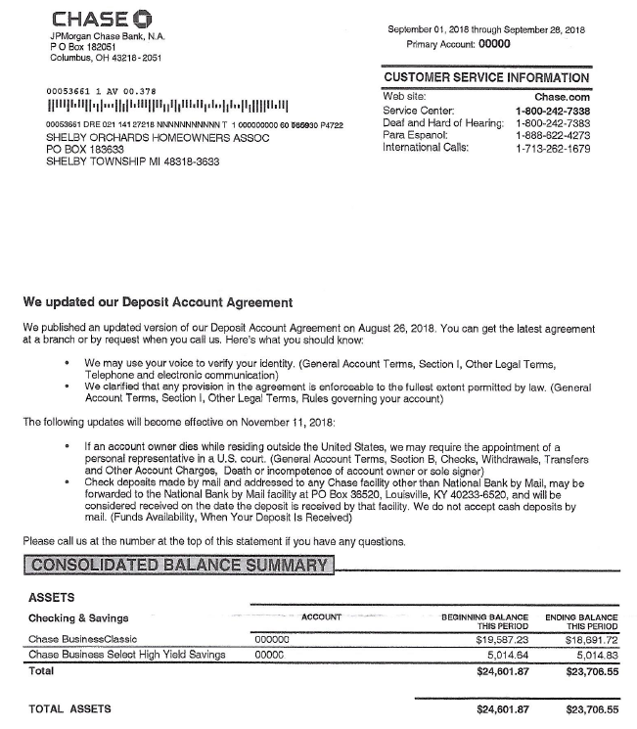

Slide 9
2019 Annual Dues and Budget
The 2019 dues will remain at $190 per household.
Expectation of 100% dues collection every year
2019 Budget is scheduled to achieve a minimal surplus

Slide 10
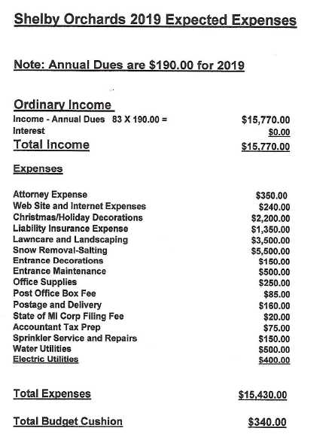

Slide 11
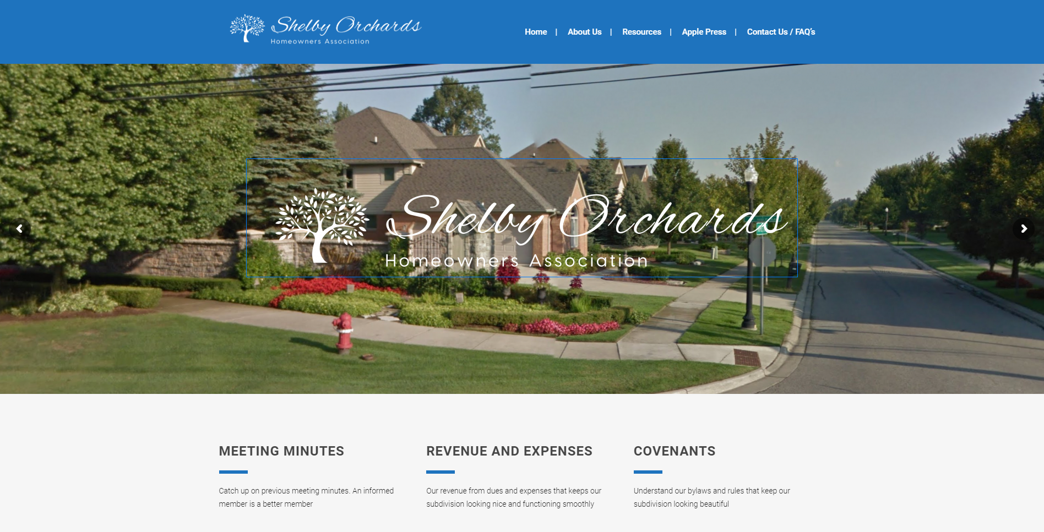
Old Business
New Subdivision Website
www.shelbyorchards.org
Trimmed the trees and bushes on east side of the front entrance

Slide 12
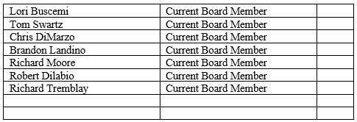
New Business
Neighborhood Maintenance
New snow removal and front entrance weeding contracts
Individual Households – Trim tree limbs over sidewalks and road
Board Elections – New Nominations

Slide 13
